Slide 1
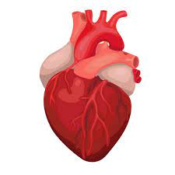
Heart Disease Diagnostic- Analysis
DETAIED PROJECT REPORT

Slide 2
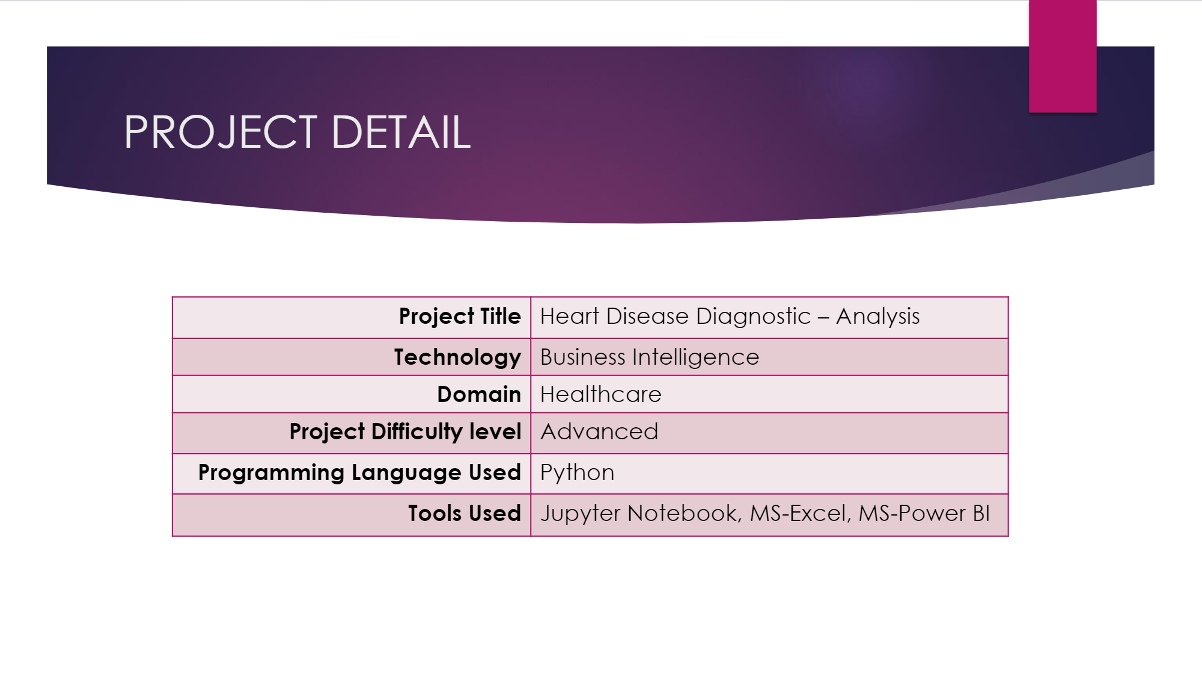

Slide 3


Slide 4
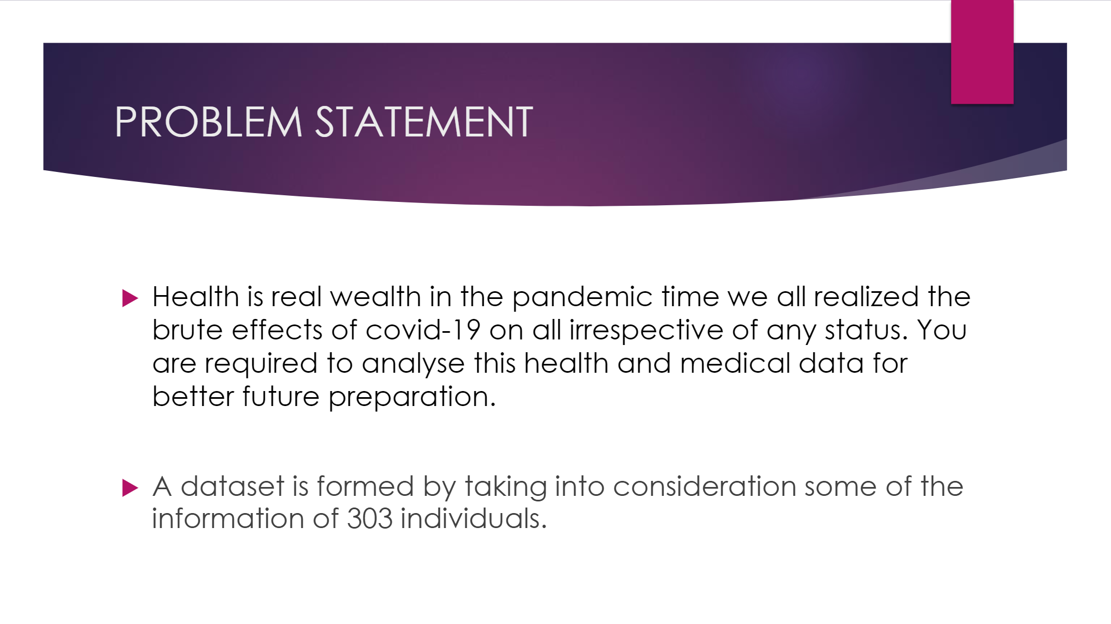

Slide 5
